Slide 1


FoodX
Yijie Wang B00782502
Sourav Das B00785668
David Rae B00748514
Aoxiang Zhang B00794930
Mani Teja B00859456
Syed Abrar B00832133
CSCI 4193

Slide 2
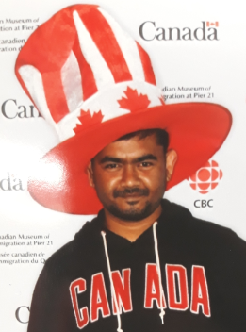
Sourav Das – Tech and Business Strategist

Slide 3

Aoxiang Zhang – Back-end Developer

Slide 4

Syed Abrar– Front-end Developer

Slide 5
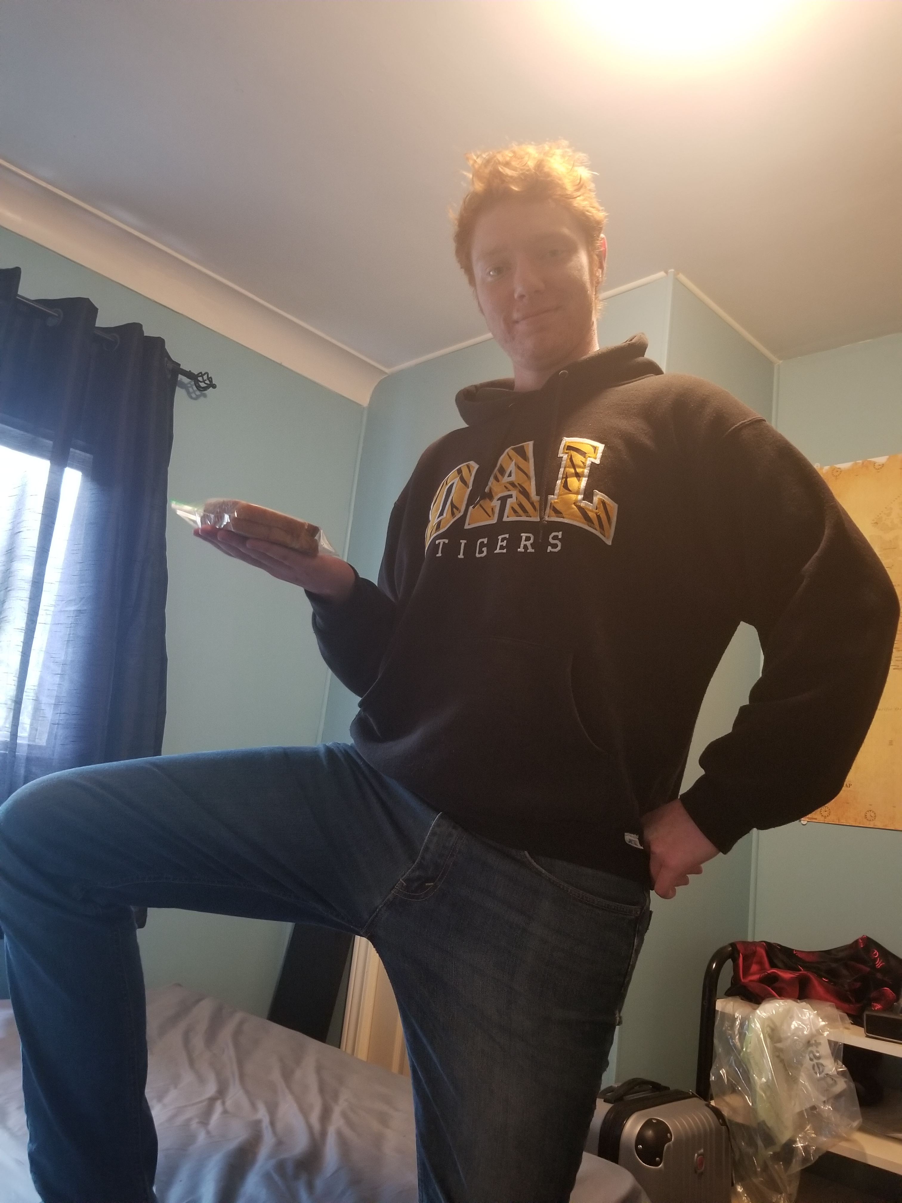
David Rae – Front-end Developer

Slide 6

Mani Teja Varma – Full Stack Developer

Slide 7

Yijie Wang – Product Lead

Slide 8
Challenges
People don't know what to eat to stay fit
People are too busy to stay fit and healthy
It's hard to know the nutrition value of each grocery item
Meal Prepping is time-consuming
People are fed up with eating the same thing over and over

Slide 9
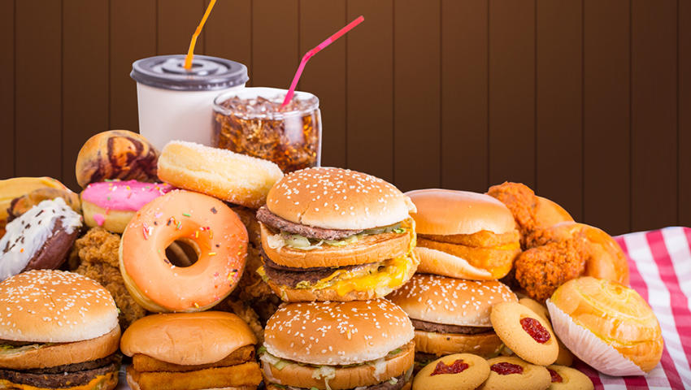

Slide 10
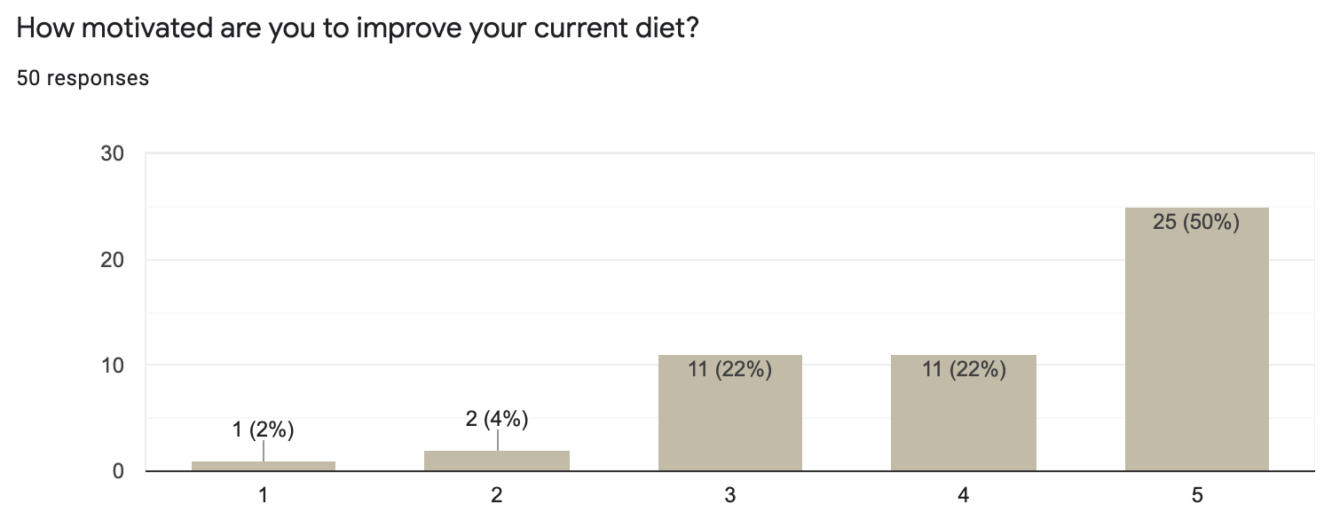
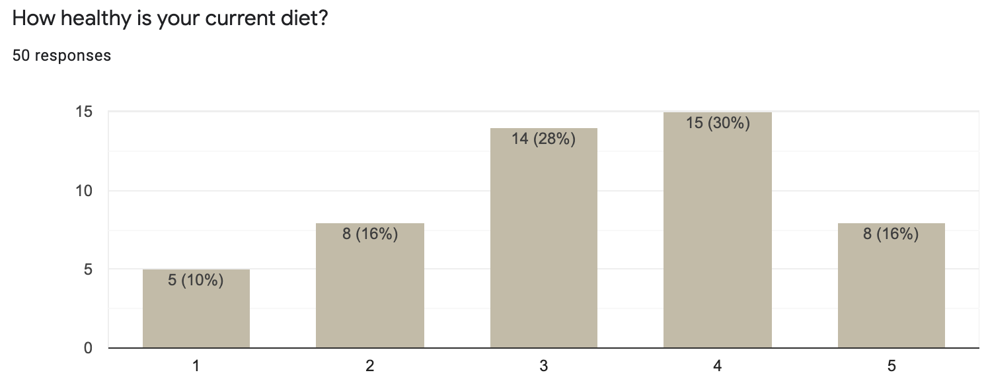
Data Analytics

Slide 11
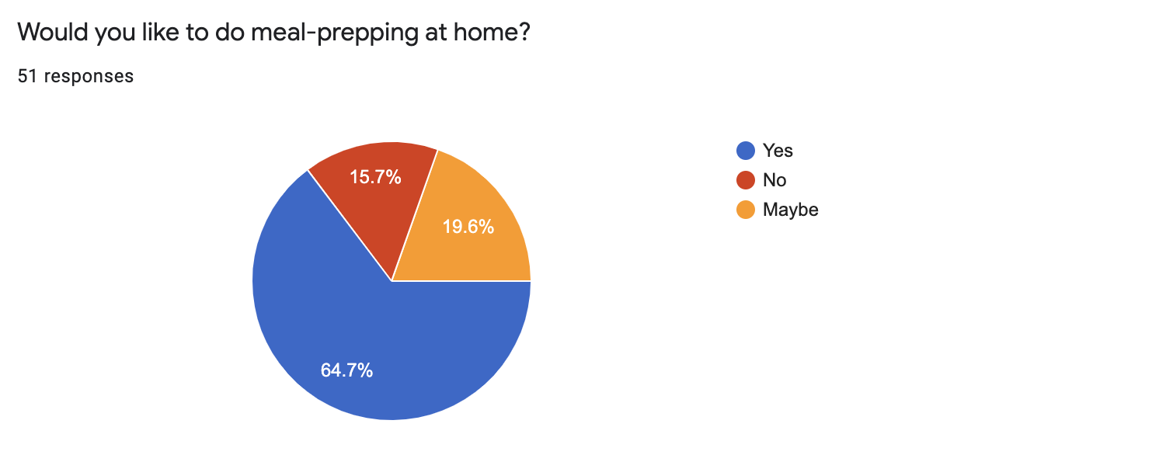

Slide 12
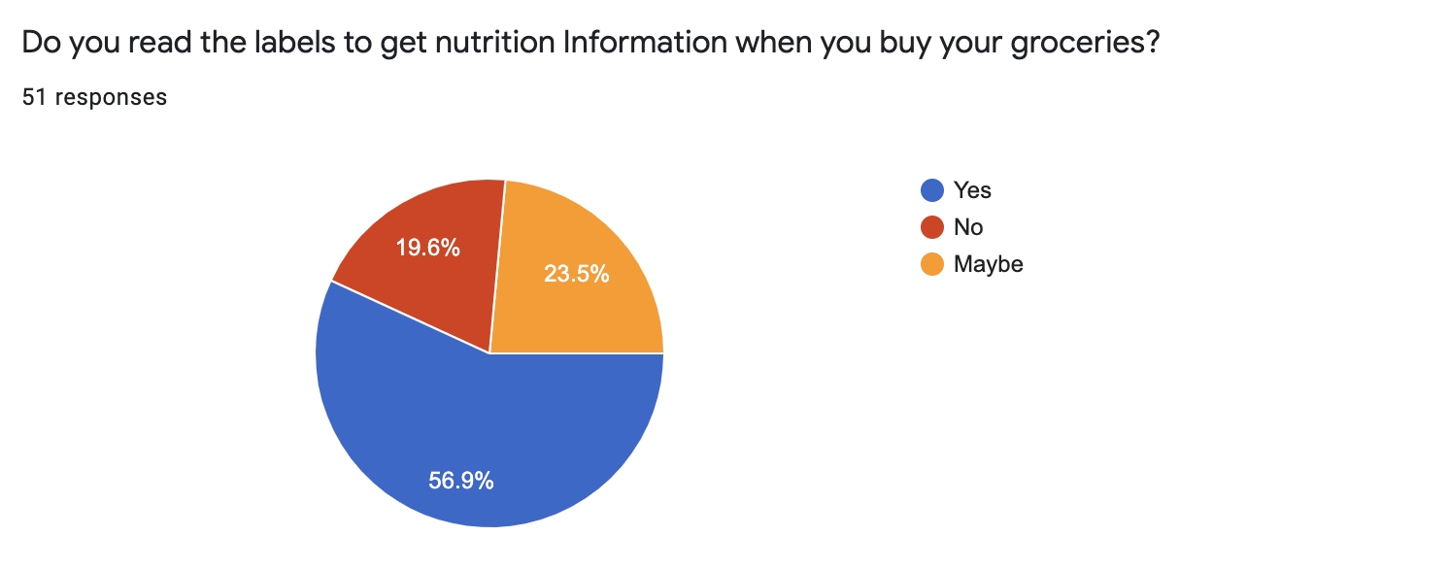

Slide 13
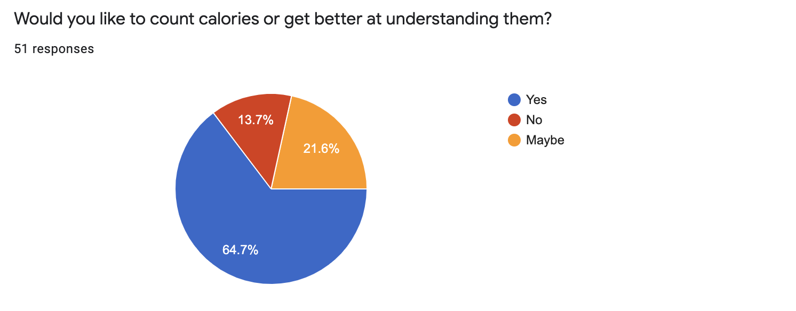

Slide 14
Solution
A meal planner that helps people make meal plans based on the grocery stores they go to

Slide 15
How it solves the problems
Provides people with nutrient information and analysis
Saves time planning and buying your food
Providing the local availability of good food helps people eat better and more interesting food

Slide 16
Customer segments
Body Builder
Young Professional
Entrepreneurs
Students

Slide 17
Unique Value Proposition
Not only right foods, but also right potion and right timing
Nearby grocery stores
Delivery options
Saves time and effort

Slide 18
Unfair Advantages
First mover in this specific market
Founders are well-connected with influencers
Founder are well-connected with the fitness community

Slide 19
Channels
Online ads
Social media
Influencers
Commercials at grocery stores

Slide 20
Cost Structure
Activity | Fixed cost $ | Variable cost $
Survey and Feedback | 2000 | X
Development | 10000 | 5000-10000
Hosting and Maintenance | 5000 | X
Marketing | 5000 | X
Customer Service | 2000 | X
Total | 24000 | 5000-10000

Slide 21
Revenue Streams
Subscriptions
Commission
Advertisements
Data

Slide 22
Key Metrics
Number of accounts being created
Number of visits
Number of orders being placed
Time taken to fulfil and delivery
Number of stores participating
Money amount of each order on average

Slide 23
Impact
Saving time of preparing meal plans and travelling to stores
01
Eating right types of food in right quantities makes the users healthier
02
Providing people better knowledge about their diet
03
Giving wider variety of food options
04
Reducing the stress of meal planning in busy times
05

Slide 24
ASK
We need mentors and advice!

Slide 25

Thank you!

